Slide 1

Project Proposal Phase 2
Checkers
By CS 301 Group 1
Notes:
Zayd starts by introducing himself then Noor and Hasib follows

Slide 2


Project Demo:
Notes:
Zayd explains the video

Slide 3

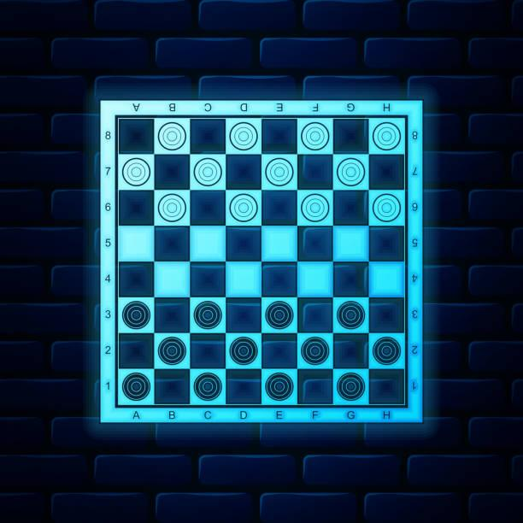
Project Demo
Main Function
Player Object
Piece Object
Board Object
Layered Development Schedule Progress
What’s Next?
Project Overview
Notes:
Noor talks about the table of contents

Slide 4
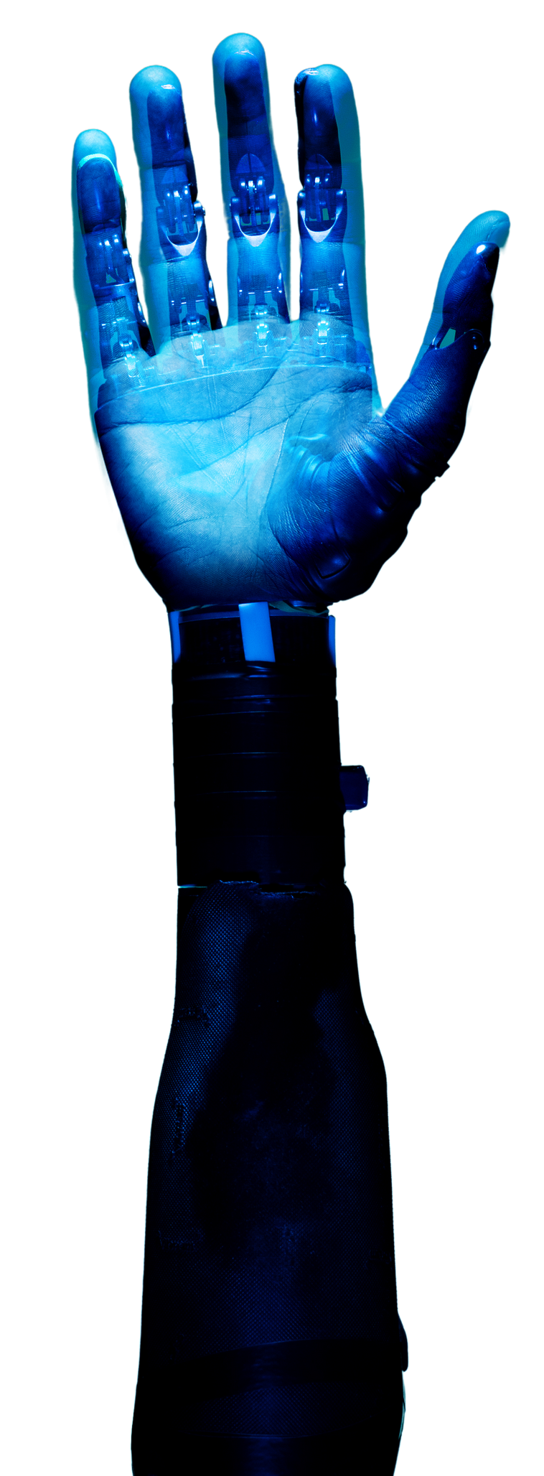
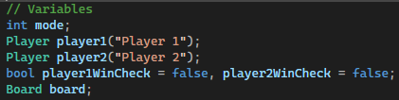
Main Function: Variables
Notes:
Hasib will speak here.
Talks about the variables for the CheckerGame.cpp function

Slide 5
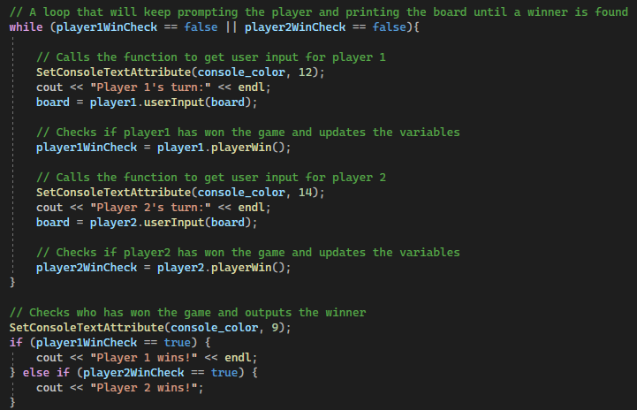
Main Function: Code
Notes:
Hasib will speak here.
Talks about the loop that keeps the game going forever till a winner is decided

Slide 6
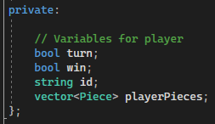
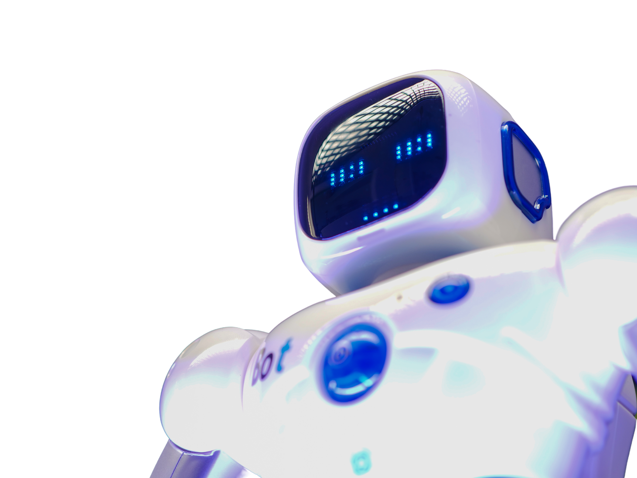
Player Object: Variables
Notes:
Zayd will speak here.
Talks about the player’s variables

Slide 7
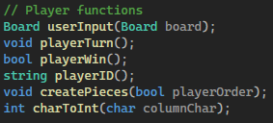
Player Object: Functions
Notes:
Zayd will speak here.
Talks about the player’s functions

Slide 8
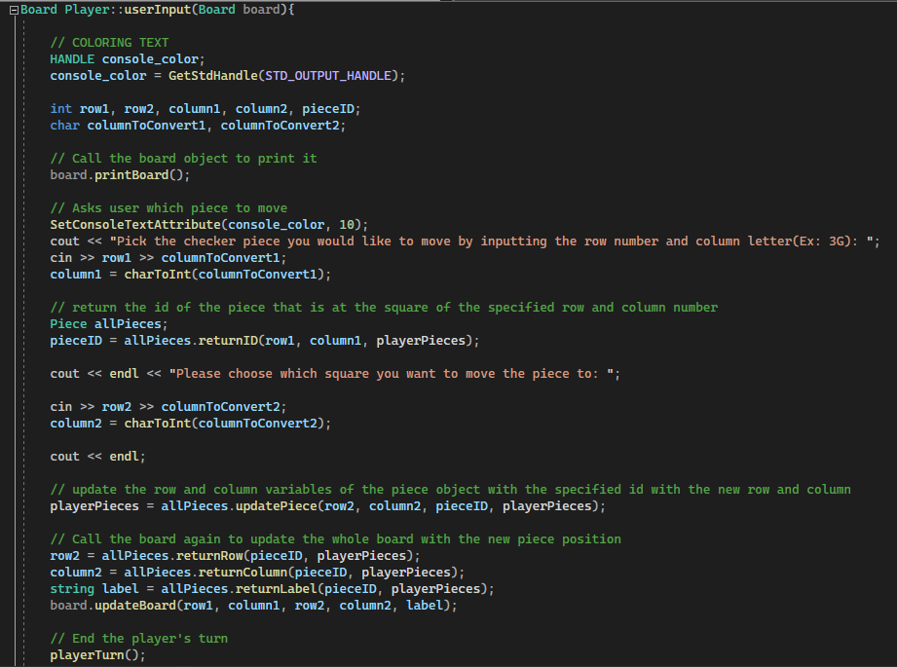
Player Object: Code
Notes:
Zayd will speak here.
Talks about the userInput function and how it manipulates the everything else

Slide 9

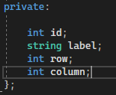

Piece Object: Variables
Notes:
Hasib will speak here.

Slide 10
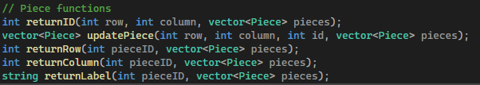
Piece Object: Functions
Notes:
Hasib will speak here.

Slide 11
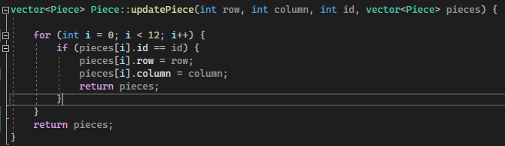
Piece Object: Code
Notes:
Hasib will speak here.

Slide 12
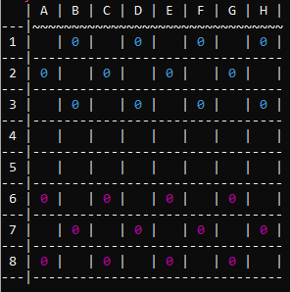
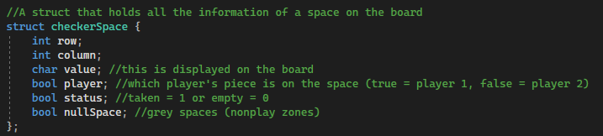
Board Object: Variables
Notes:
NOOR:
explain struct and 2d array

Slide 13
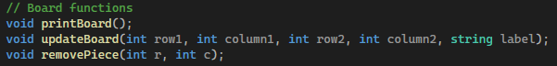
Board Object: Functions
Notes:
NOOR:
explain the functions in depth

Slide 14
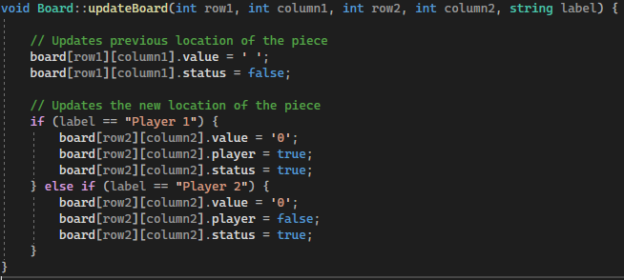
Board Object: Code
Notes:
NOOR:
explain updateBoard function in depth

Slide 15
Layered Development Schedule Progress
Complete | Incomplete | Extra
Player object class Checker piece object class Board object class void updateBoard() void printBoard() void removePiece() Board userInput() | void jump() bool promote() bool moveCheck() bool jumpCheck() bool jumpedOver() void multipleJump() bool multipleJumpCheck() int PossibleMove() void promoteMove() Create an AI object class Extra features | void playerTurn() bool playerWin() string playerID() void createPieces() int charToInt() int returnID() vector<Piece> updatePiece() int returnRow() int returnColumn() string returnLabel()
Notes:
The 3 of us talk about in order of what we have completed from our layers, what we haven’t completed from the layers, and the extra functions we added that was mentioned

Slide 16
THANK YOU!
Notes:
Zayd concludes
“And that's our project plan for phase 2, thank you”

